Slide 1
DBMS Shadow Paging

Slide 2
Shadow Paging is recovery technique that is used to recover database.
In this recovery technique, database is considered as made up of fixed size of logical units of storage which are referred as pages.

Slide 3
pages are mapped into physical blocks of storage, with help of the page table which allow one entry for each logical page of database.
This method uses two page tables named current page table and shadow page table.

Slide 4
The entries which are present in current page table are used to point to most recent database pages on disk.
Another table i.e., Shadow page table is used when the transaction starts which is copying current page table.

Slide 5
After this, shadow page table gets saved on disk and current page table is going to be used for transaction.
Entries present in current page table may be changed during execution but in shadow page table it never get changed.
After transaction, both tables become identical.

Slide 6
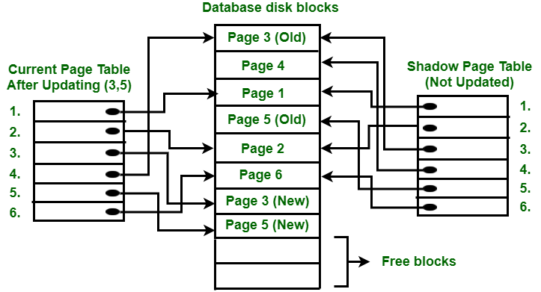

Slide 7
To understand concept, consider above figure. In this 2 write operations are performed on page 3 and 5.
Before start of write operation on page 3, current page table points to old page 3.
When write operation starts following steps are performed

Slide 8
Firstly, search start for available free block in disk blocks.
After finding free block, it copies page 3 to free block which is represented by Page 3 (New).
Now current page table points to Page 3 (New) on disk but shadow page table points to old page 3 because it is not modified.
The changes are now propagated to Page 3 (New) which is pointed by current page table.

Slide 9
Advantages
This method require fewer disk accesses to perform operation.
In this method, recovery from crash is inexpensive and quite fast.
There is no need of operations like- Undo and Redo.

Slide 10
Disadvantages :
Due to location change on disk due to update database it is quite difficult to keep related pages in database closer on disk.
During commit operation, changed blocks are going to be pointed by shadow page table which have to be returned to collection of free blocks otherwise they become accessible.
The commit of single transaction requires multiple blocks which decreases execution speed.
To allow this technique to multiple transactions concurrently it is difficult.

Slide 11
Thank you !

